Slide 1

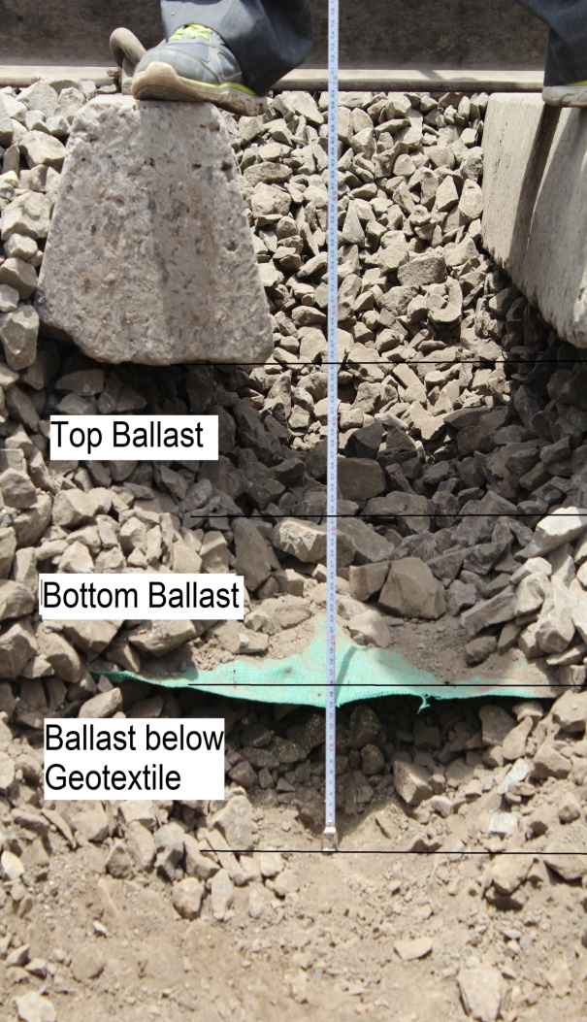
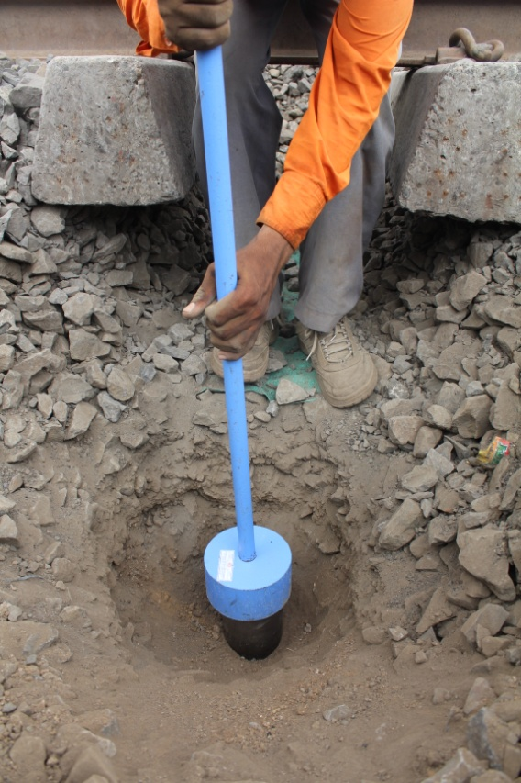
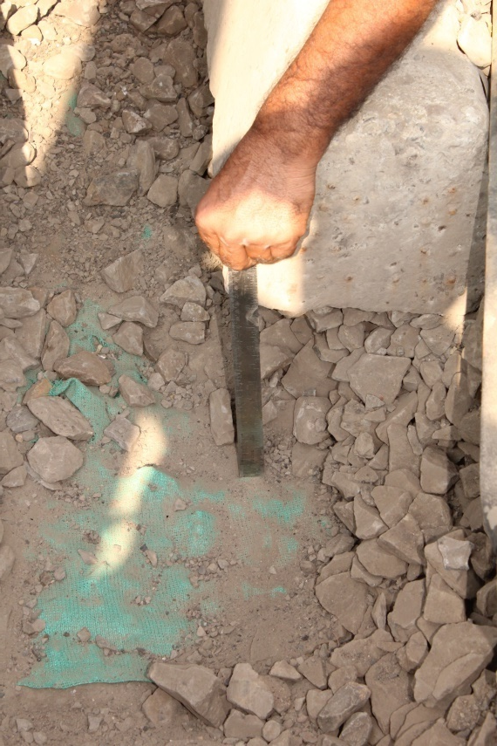
Assessment of Indian Railways Track Ballast in the Regime of Semi High Speed & Heavy Axle Load
Saurabh Singh, IRSE-13, M.Tech (RTC) student, ADEN/FZD/NCR
R. P. Singh, Asst Professor/Track, IRICEN-Pune
Crushed Ballast at Interface

Slide 2
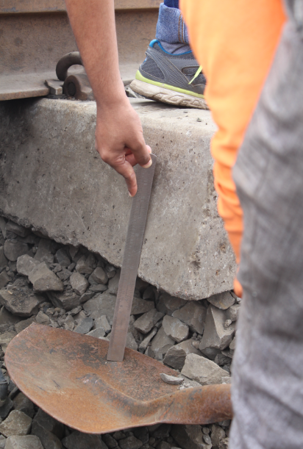
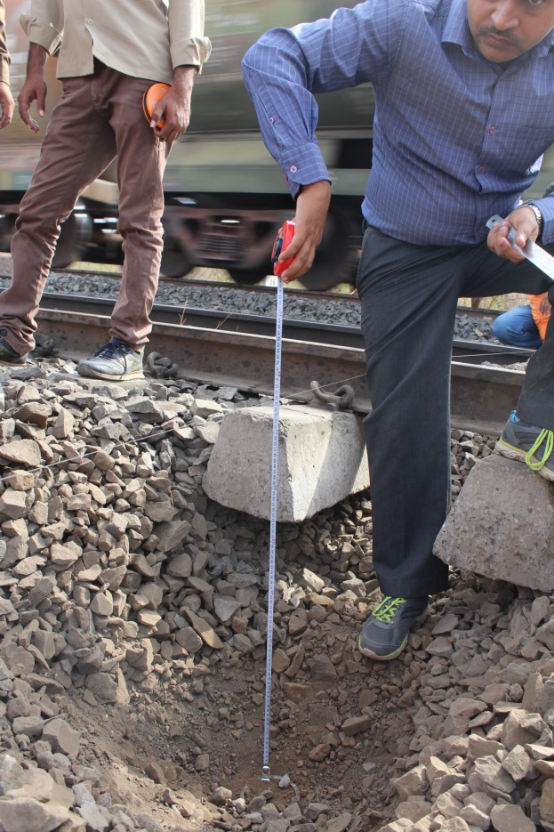
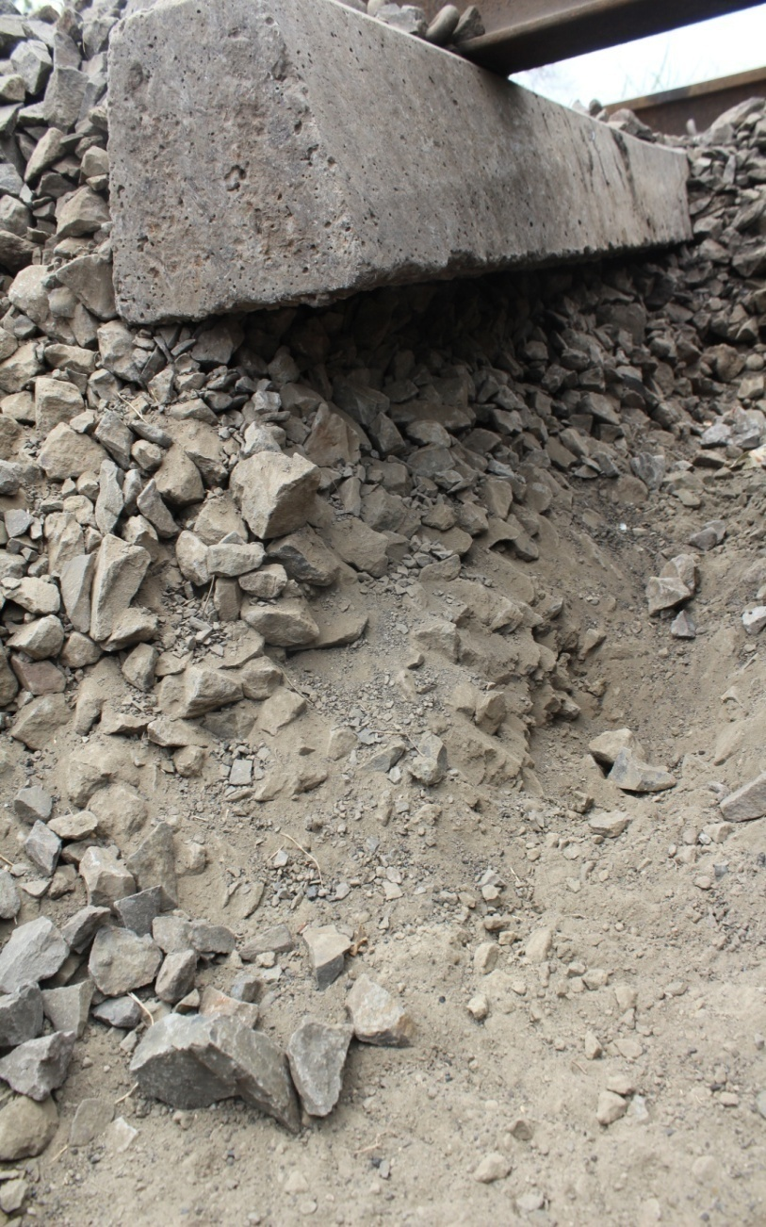
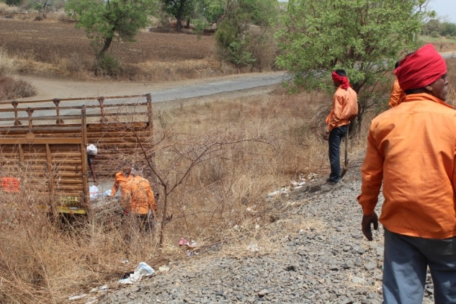
Field Investigations and Ballast Sampling for Lab Testings
Top Ballast
Bottom Ballast
Sub Ballast

Slide 3
Field Investigations and Ballast Sampling for Lab Testings
From Each Location 3 different samples were collected. (Top Ballast, Bottom Ballast & Sub Ballast)
Each Sample is about 15-20 Kg.
Details of Sampling Locations : C Rly, BSL Divn, AK - BSL Section
Geotextile was laid in 2007 and 2012 along with BCM on experimental basis. The Geotextile used is green net and not as per international standards.
Sr No. | Sample No. | Road | Chainage | Lattitude | Longitude | Date of Deep Screening | Years after DS | GMT Passed
1 | 30 | DN | 495/6 | 20˚53.393' | 76˚12.779' | March’ 07 | 9 | 347
2 | 34 | DN | 496.00 | 20˚53.337' | 76˚13.365' | March’ 07 | 9 | 347
3 | 35 | DN | 496/6 | 20˚53.334' | 76˚13.289' | March’ 07 | 9 | 347
4 | 37 | DN | 486.30 | 20˚54.271' | 76˚07.784' | March’ 07 | 9 | 347
5 | 4 | UP | 472.00 | 20˚54.910' | 75˚59.907' | April’ 12 | 4 | 226.92
6 | 12 | UP | 468.00 | 20˚56.397' | 75˚58.531' | April’ 12 | 4 | 226.92

Slide 4
Cost Assessment of Indian Railways Track Ballast
Expenditure on Ballast per year (in Crore Rupees)
Description | Maintenance | Construction
 | 2015-16 | 2015-16
Track Kilometers (in Kms) | 1,15,000 | 1600
Renewal Required (in Kms) | 11,500 | 1600
Ballast Required (in 000 m³) For maint. 1100m³/kms For new lines 2250m³/kms | 12650 (actually 7700) | 3600
Expenditure in (Crores Rs.) | 900 | 400
Total Exp. in 2015-16 | 1300
Tentative Exp. in 2016-17 | 1800
Tentative Exp. in 2017-18 | 2200

Slide 5
Specification IRS GE-1 2016 (comparison)
IR Limits are continuing from East India Rail Company Time.
Very conservative; may be previously hand crushed ballast was used
Properties are ‘source independent’ (dolamite, limestone etc.)
Aggregate Impact Value test as per IS 2386 Part IV 1963. This test is for aggregate of size 10mm to 12.5mm which would not represent the exact ballast. Australian Railway Standard AS2758.7 recommends use of the fraction of material passing the 53 mm sieve and retained on the 37.5 mm sieve. Indian Railways needs to modify this provision.
Have no specification for specific gravity, bulk density, particle density, and soundness whereas other railways have this specification.
Have no specification for particle shape, flakiness and elongation are subjective whereas other railways have well defined methodology.
No mention about Electrical Resistivity.

Slide 6
COMPARISON OF BALLAST SPECIFICATIONS OVER WORLD RAILWAYS
Parameter/ Property | IR | American Rly | Australian Rly | Canadian National Rly |  | European Rly
Particle Gradation | Poorly Gradaed | Well Graded
Soundness | No | √ | √ |  | √ | √
Crushing Value | Impact Value | Size range matching the actual ballast in track.
Abrasion Value | LAA | MA & LAA | √ |  | √ | √
Electrical Resistivity | No | √ | √ |  | √ | No
Bulk Sp. Gr. | No | √ | No |  | No | No
Flakiness & Elongation | No | √ | √ |  | √ | √
Chemical Analysis | No | √ | No |  | No | No

Slide 7
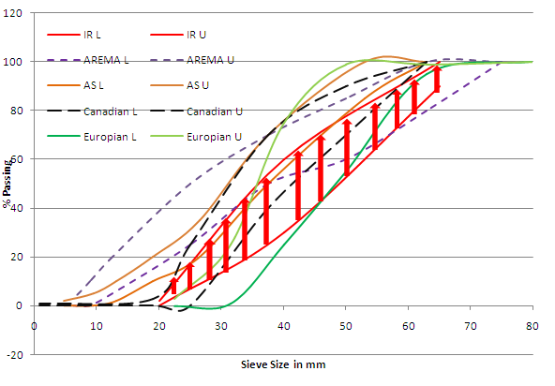
Comparison of Ballast gradation curves

Slide 8
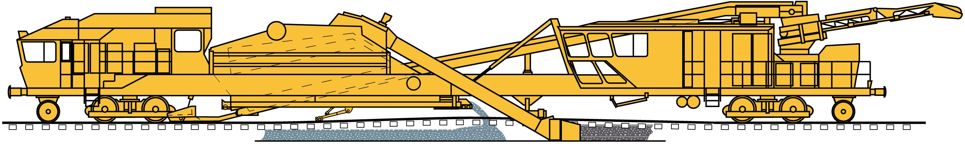
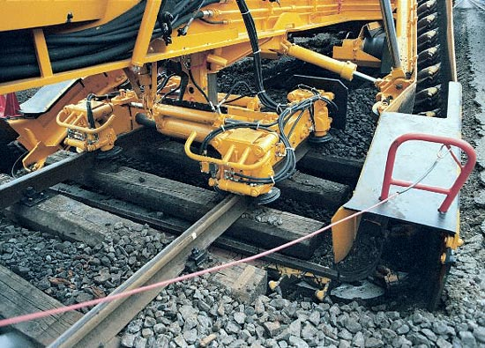
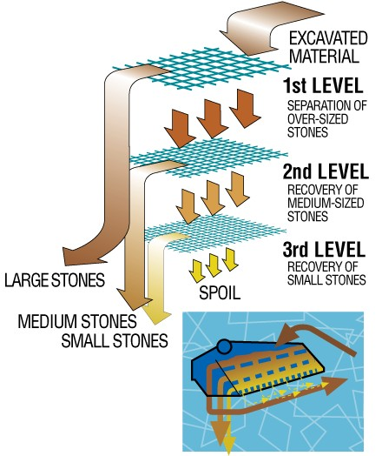
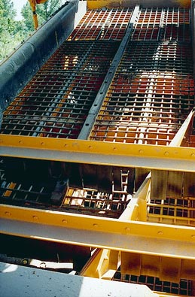
1. Mechanised Deep Screening of Ballast
80 | 65
50 | 40
36 | 20
Source : IRICEN Library

Slide 9
2. Degradation Analysis of Ballast

Slide 10

3. Degradation analysis of Ballast with Geotextile
Bottom Ballast
Crushed Ballast at Interface

Slide 11
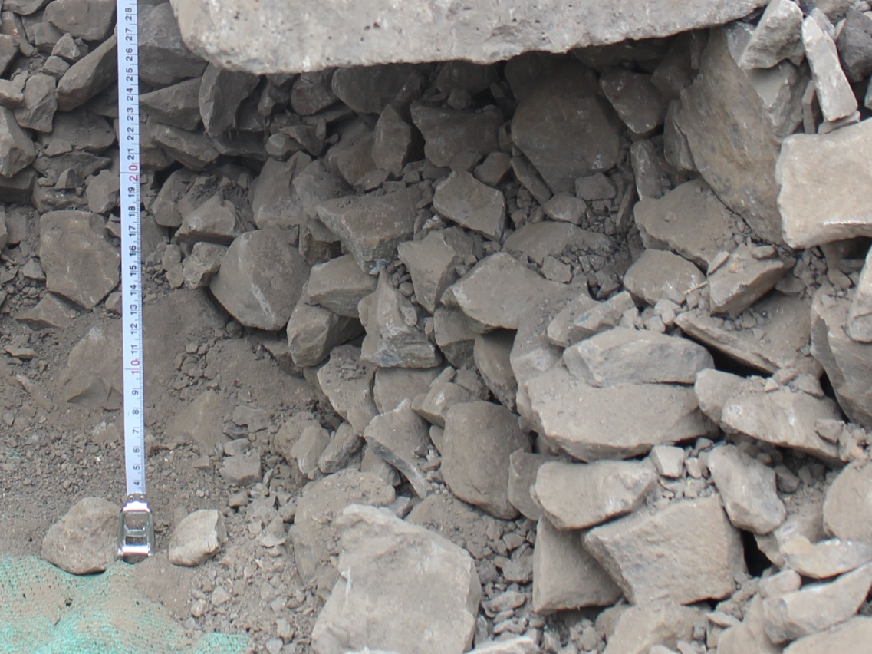
4. Fouling of Ballast
(Anbazhagan et al.,2012)
Sample No. | GMT | Fouling Index (FI) |  |  | % Fouling
 |  | Selig and Water (1994) | Ionescu (2004) | Anbazhagan et al. (2012) | Ionescu (2004) | Anbazhagan et al. (2012)
37 | 347 | 2.01 | 5.00 | 11.82 | 2.80 | 11.82
35 | 347 | 2.92 | 6.12 | 10.42 | 4.03 | 10.42

Slide 12
Ballast Fouling With Increase in GMT
Highly Fouled
Fouled
Moderately Fouled
Moderately Clean
Clean

Slide 13
5.Improvement in TGI after Geotextiles
Kilometers | After Laying of Geo-textiles |  | Before Laying of Geo-textiles
 | May 2013 | September 2012 | July 2011
464-465 | 97 | 83 | 82
465-466 | 102 | 78 | 83
466-467 | 122 | 99 | 92
467-468 | 123 | 102 | 97
468-469 | 107 | 97 | 99
469-470 | 108 | 100 | 99
470-471 | 105 | 96 | 109
485-486 | 101 | 77 | 78
486-487 | 106 | 85 | 70
487-488 | 95 | 79 | 57
488-489 | 110 | 78 | 60
489-490 | 105 | 81 | 54
490-491 | 111 | 87 | 86
Avg. | 102.03 | 84.297 | 77.378

Slide 14
RECOMMENDATIONS
Deep screening periodicity may be increased to 15 years in such region where ballast fouling is less due to use of Geotextiles or where rainfall is less.
DS to be based on some quantitative parameter such as FI or % void contamination, Criteria should be dependent on environmental conditions also.
The properties should be based on the source and nature of Ballast. Indian Railways needs to adopt some strength parameters like specific gravity/density of ballast, chemical parameters, electrical resistivity etc. in the specifications.
Impact Value Test to be redefined.

Slide 15

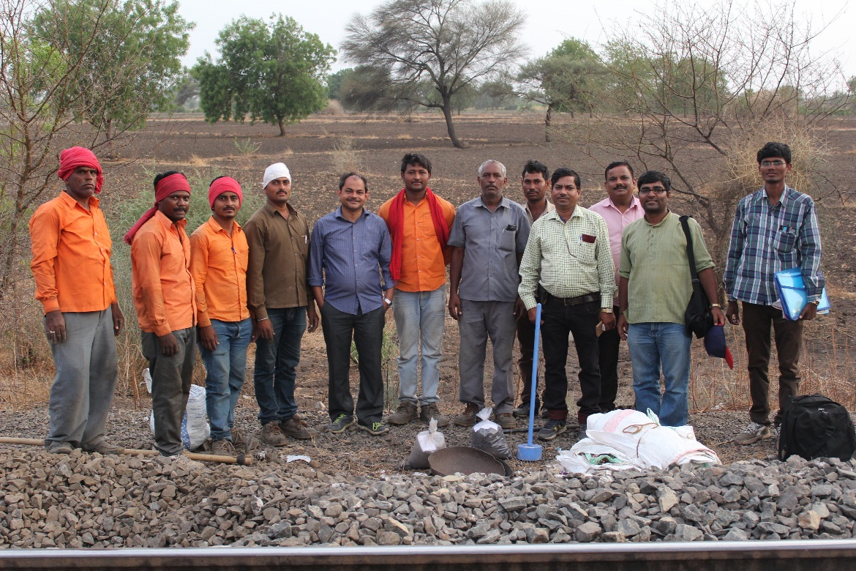
Value Engineering
Thanks

